Slide 1

332:479 Concepts in VLSI
Design
Lecture 12
Circuit Families
David Harris and Mike Bushnell
Harvey Mudd College and Rutgers University
Spring 2004

Slide 2
Outline
Pseudo-nMOS Logic
Dynamic Logic
Pass Transistor Logic
Summary
Material from: CMOS VLSI Design
By Neil E. Weste and David Harris

Slide 3
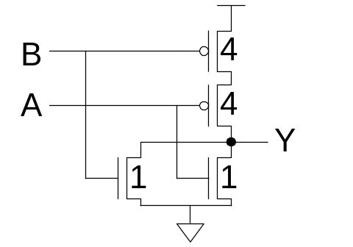
Introduction
What makes a circuit fast?
  I = C dV/dt -> t_{pd} ∝ (C/I) ΔV
  low capacitance
  high current
  small swing
Logical effort is proportional to C/I
pMOS are the enemy!
  High capacitance for a given current
Can we take the pMOS capacitance off the input?
Various circuit families try to do this…

Slide 4
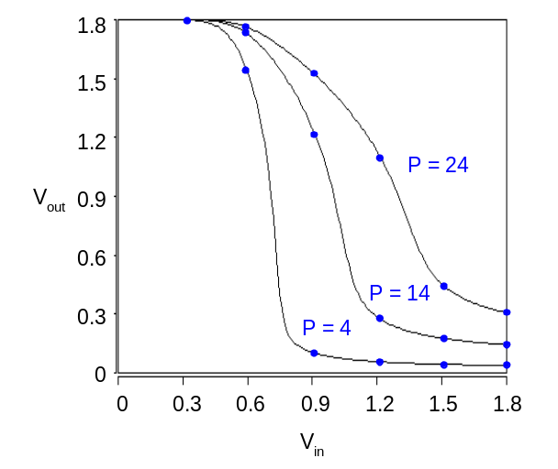
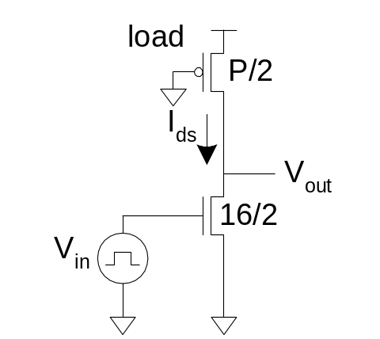
Pseudo-nMOS
In the old days, nMOS processes had no pMOS
  Instead, use pull-up transistor that is always ON
In CMOS, use a pMOS that is always ON
  Ratio issue
  Make pMOS about ¼ effective strength of pulldown network

Slide 5
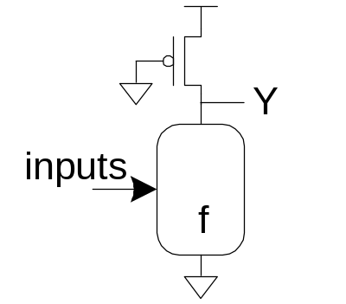
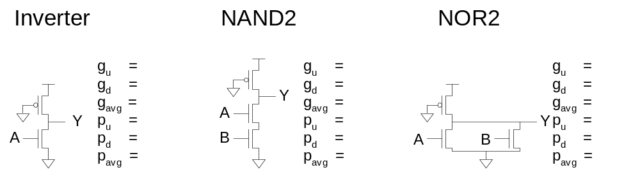
Pseudo-nMOS Gates
Design for unit current on output
to compare with unit inverter.
pMOS fights nMOS

Slide 6
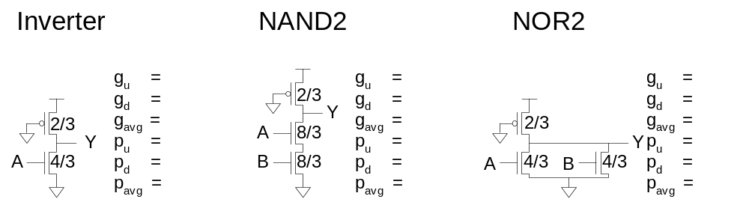
Pseudo-nMOS Gates
Design for unit current on output
to compare with unit inverter.
pMOS fights nMOS

Slide 7
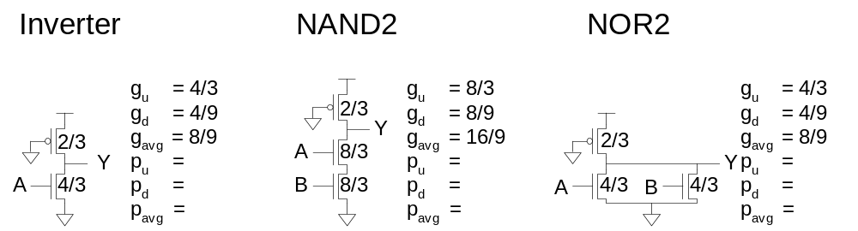
Pseudo-nMOS Gates
Design for unit current on output
to compare with unit inverter.
pMOS fights nMOS

Slide 8
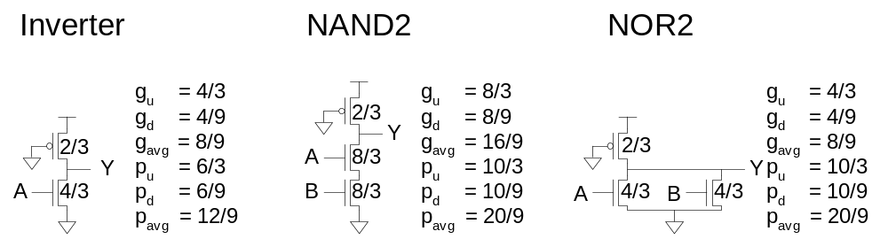
Pseudo-nMOS Gates
Design for unit current on output
to compare with unit inverter.
pMOS fights nMOS

Slide 9
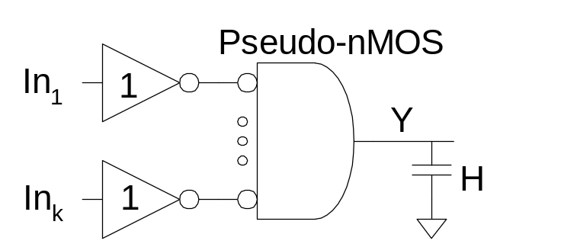
Pseudo-nMOS Design
Ex: Design a k-input AND gate using pseudo-nMOS. Estimate the delay driving a fanout of H
G =
F =
P =
N =
D =

Slide 10
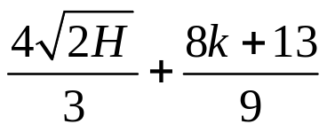
Pseudo-nMOS Design
Ex: Design a k-input AND gate using pseudo-nMOS. Estimate the delay driving a fanout of H
G = 1 * 8/9 = 8/9
F = GBH = 8H/9
P = 1 + (4+8k)/9 = (8k+13)/9
N = 2
D = NF^{1/N} + P =

Slide 11
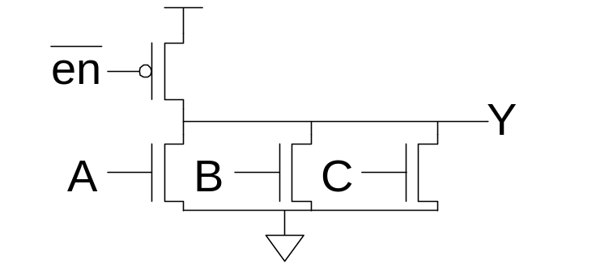
Pseudo-nMOS Power
Pseudo-nMOS draws power whenever Y = 0
  Called static power P = I•V_{DD}
  A few mA / gate * 1M gates would be a problem
  This is why nMOS went extinct!
Use pseudo-nMOS sparingly for wide NORs
Turn off pMOS when not in use

Slide 12
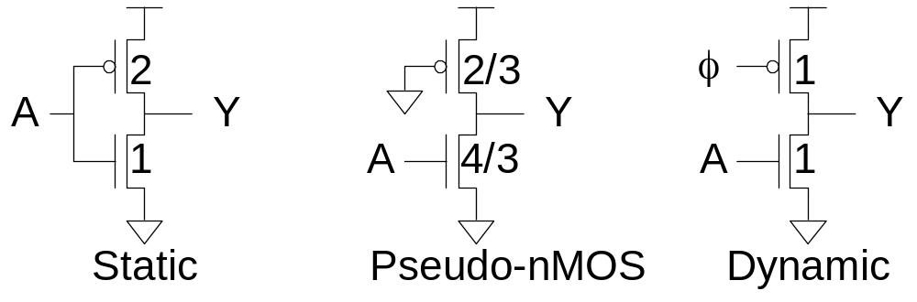
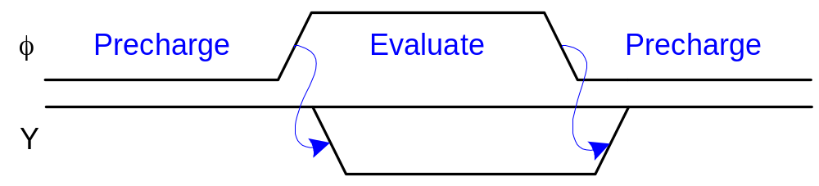
Dynamic Logic
Dynamic gates uses a clocked pMOS pullup
Two modes: precharge and evaluate

Slide 13
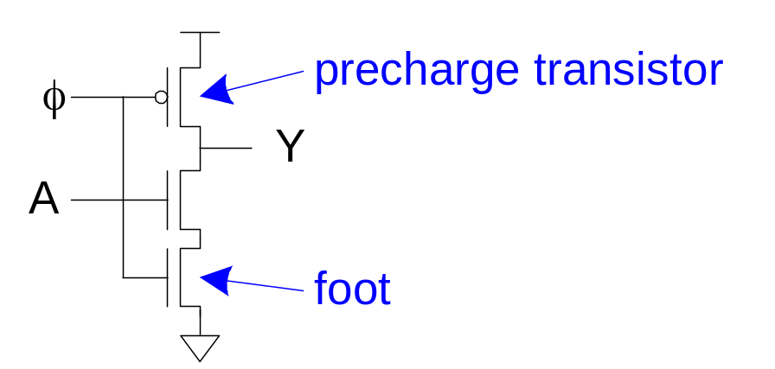
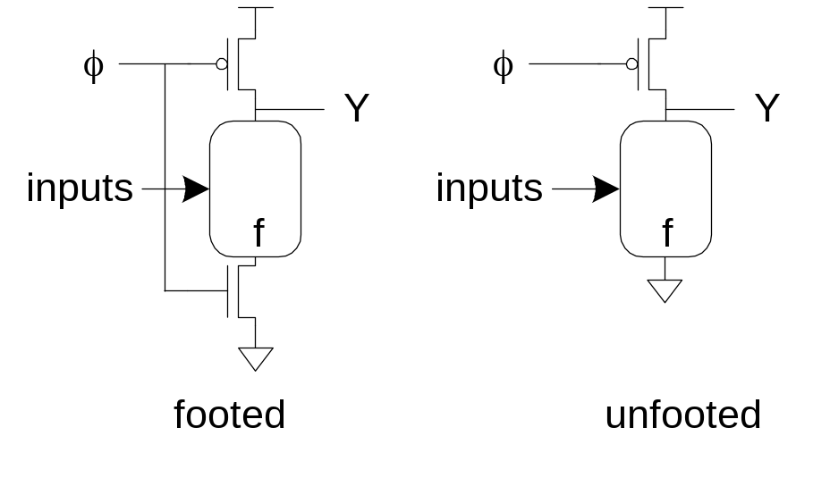
The Foot
What if pulldown network is ON during precharge?
Use series evaluation transistor to prevent fight.

Slide 14
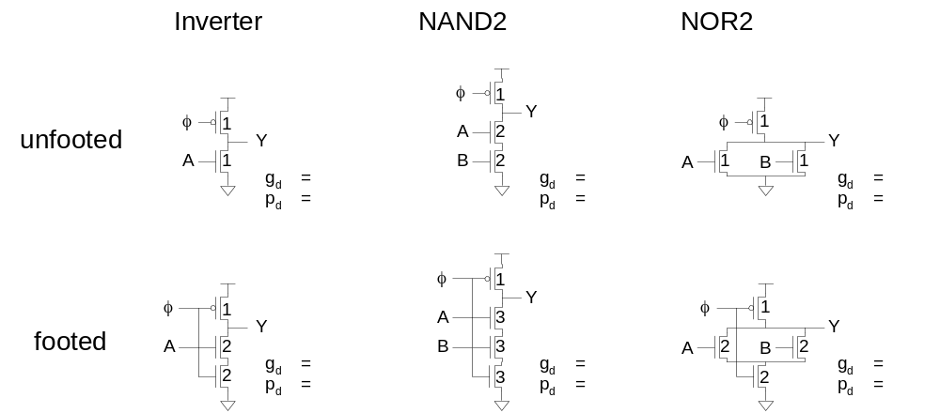
Logical Effort

Slide 15
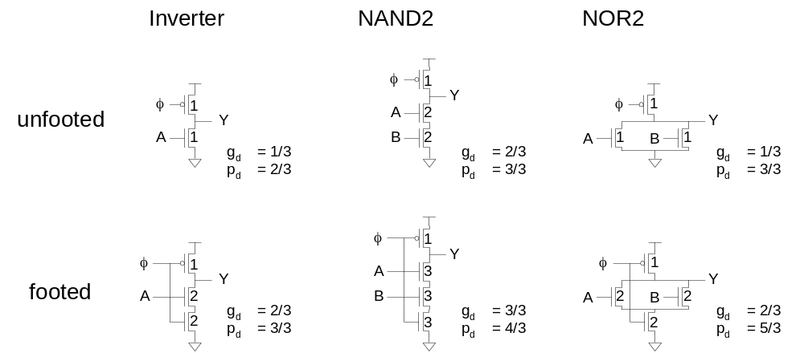
Logical Effort

Slide 16
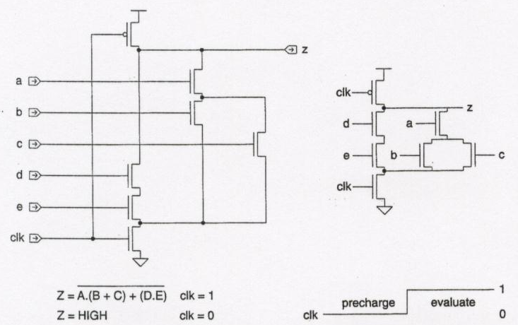
Dynamic CMOS Gates

Slide 17
Dynamic CMOS Logic
clk is single-phase clock
Input C half that of static CMOS
Pullup time greatly improved by active precharge transistor
Pulldown time slightly increased by evaluate transistor
Eliminate evaluation transistor if inputs guaranteed to be 0 during precharge
Problems:
  Inputs can change only during precharge – MUST be stable during evaluation
    Otherwise, charge redistribution gives wrong logic value
  Charge sharing at internal dynamic gate nodes can cause wrong logic value

Slide 18
Dynamic CMOS Logic
n-block dynamic gate can only drive p-block dynamic gates
  For n-block to drive n-block, must have static inverter in between
Advantages:
  Uses far less area than static CMOS – only 1 p transistor and simpler wiring
  Faster than static CMOS – precharge period can be made very short by widening precharger to give it very high β
  Each gate input has only 1 transistor load rather than 2 as in static CMOS – faster switching
  Easier to test than static CMOS – less likely to have faults turning combinational logic gates into sequential circuits

Slide 19
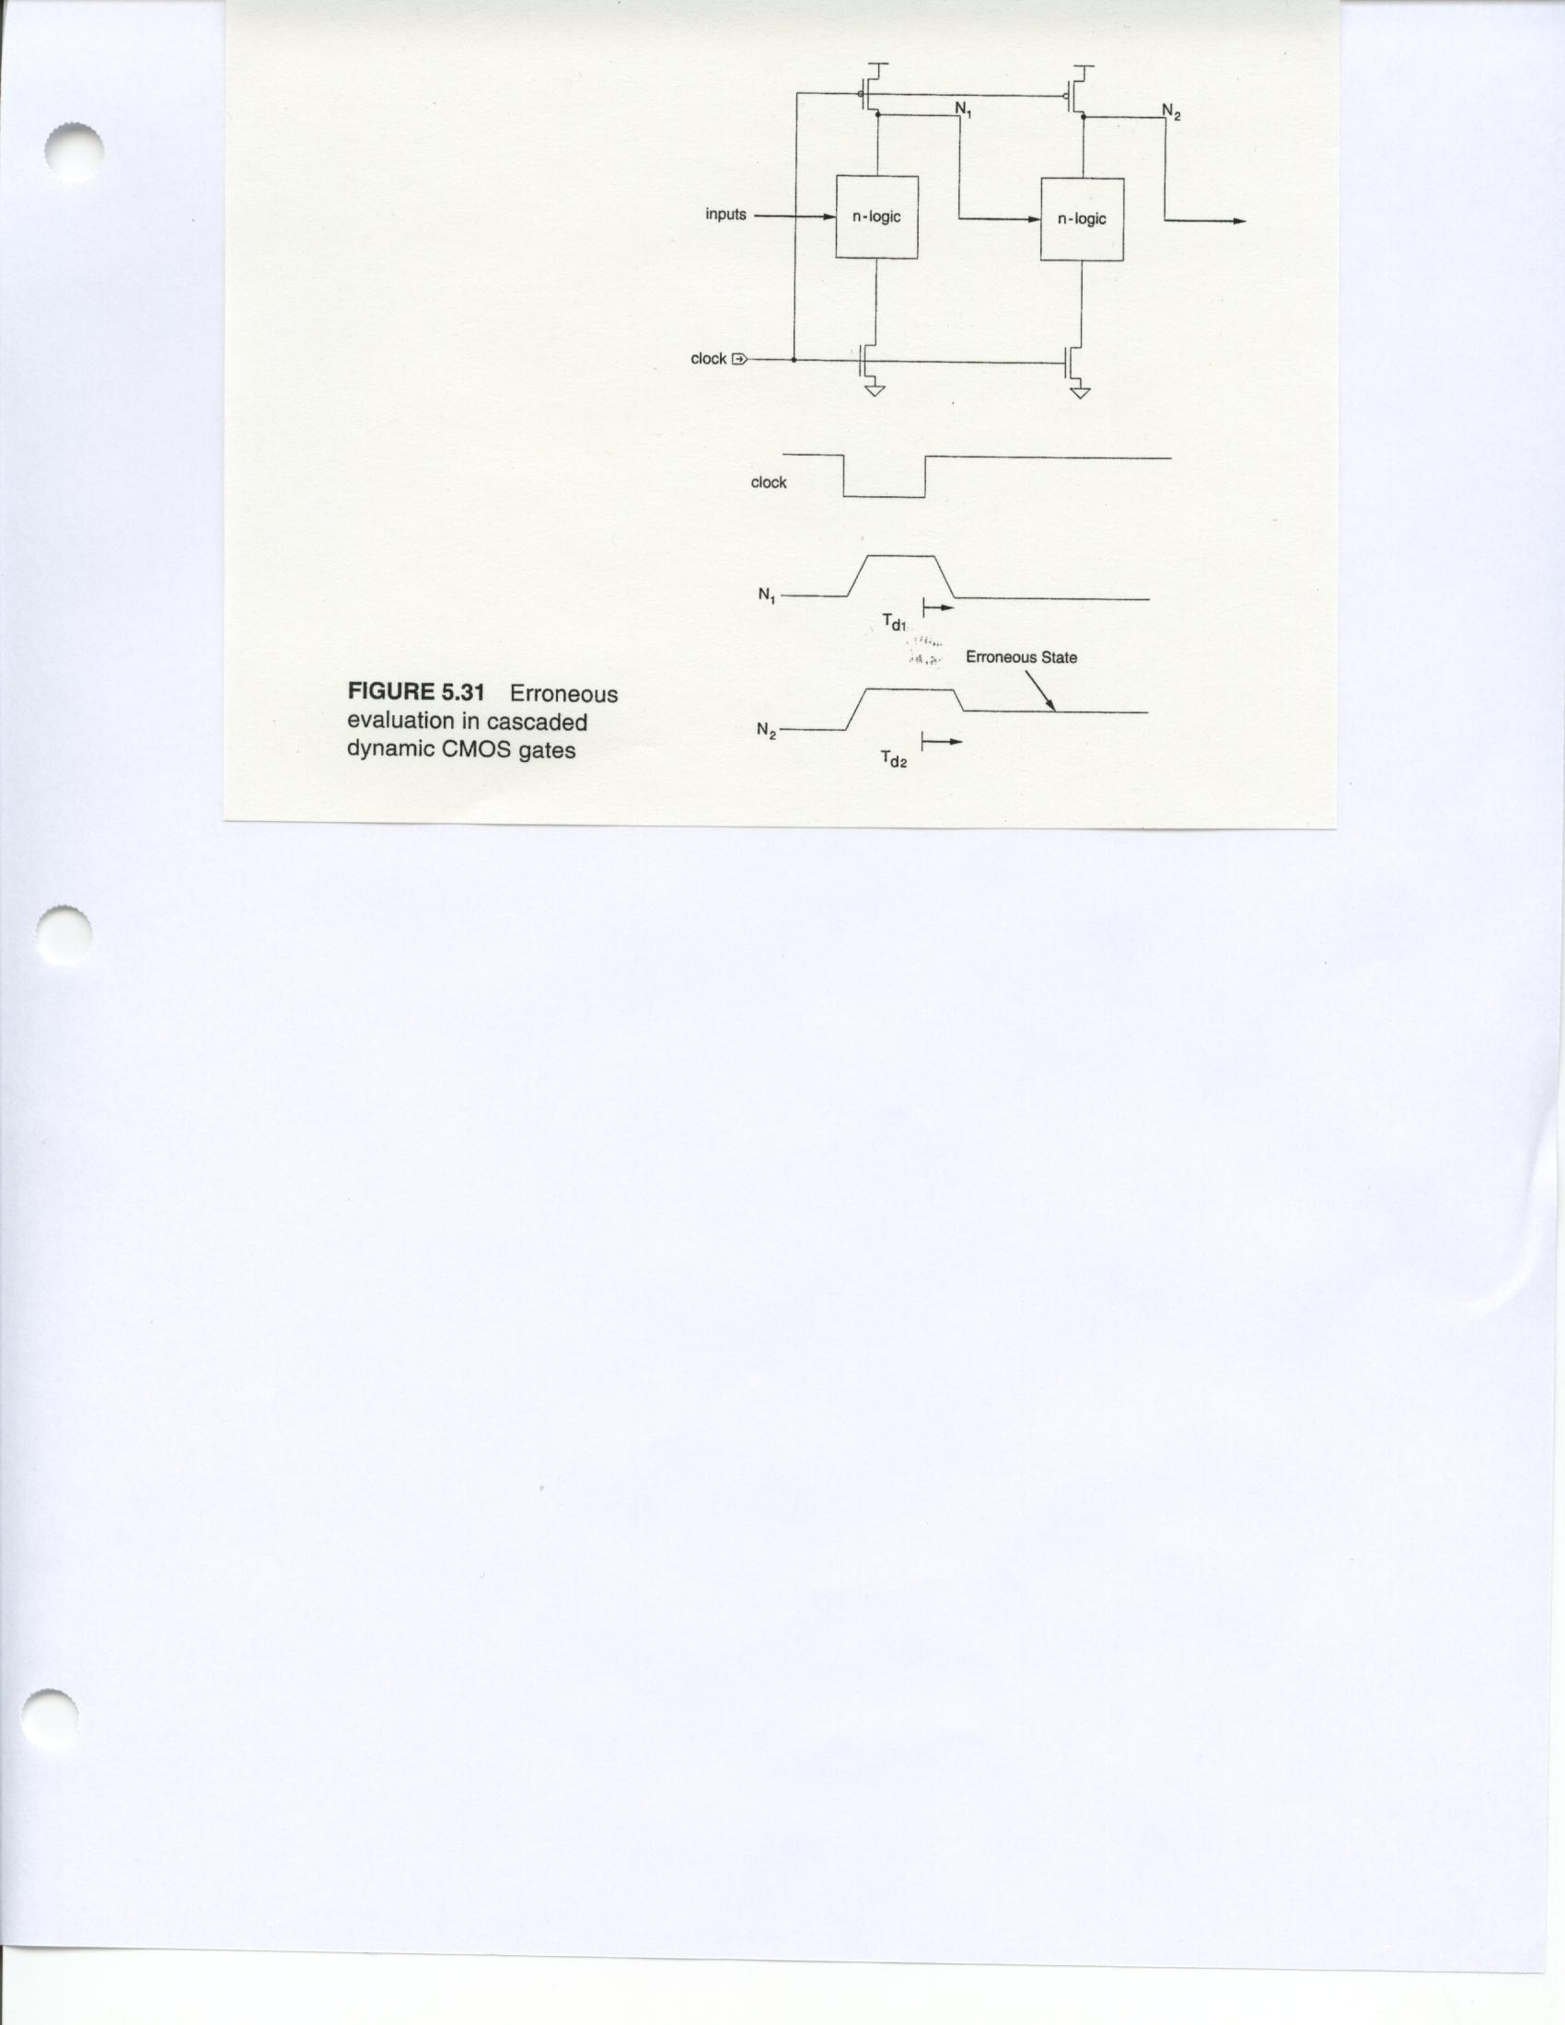
Erroneous Dynamic Gate Evaluation
Never connect gates this way!
Signal at N₁ changes during 2nd dynamic gate’s evaluation – erroneously discharges the gate

Slide 20
Erroneous Timing

Slide 21
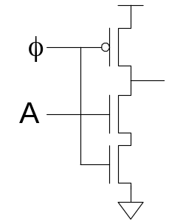
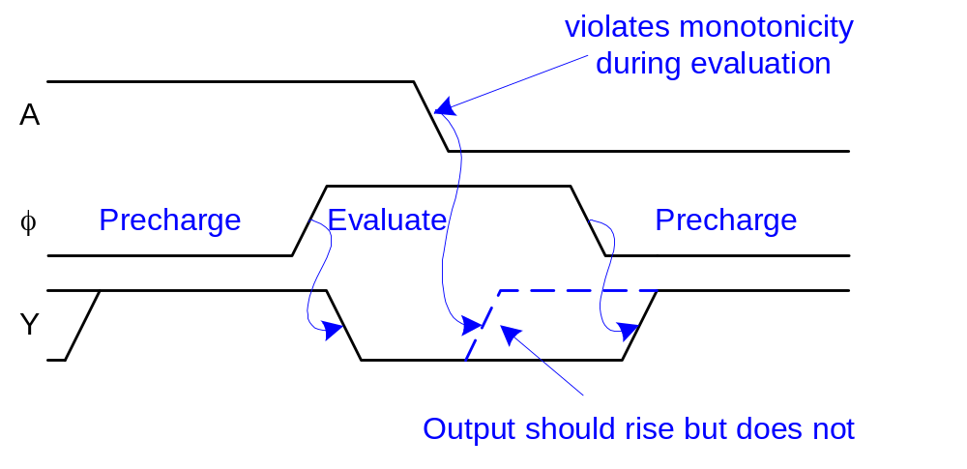
Monotonicity
Dynamic gates require monotonically rising inputs during evaluation
  0 -> 0
  0 -> 1
  1 -> 1
  But not 1 -> 0

Slide 22
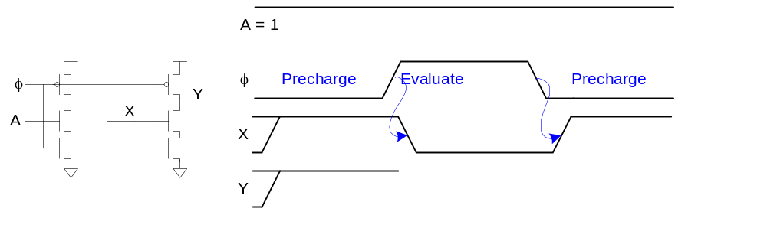
Monotonicity Woes
But dynamic gates produce monotonically falling outputs during evaluation
Illegal for one dynamic gate to drive another!

Slide 23
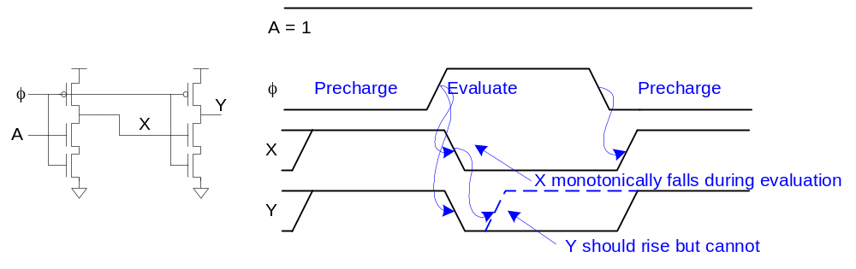
Monotonicity Woes
But dynamic gates produce monotonically falling outputs during evaluation
Illegal for one dynamic gate to drive another!

Slide 24
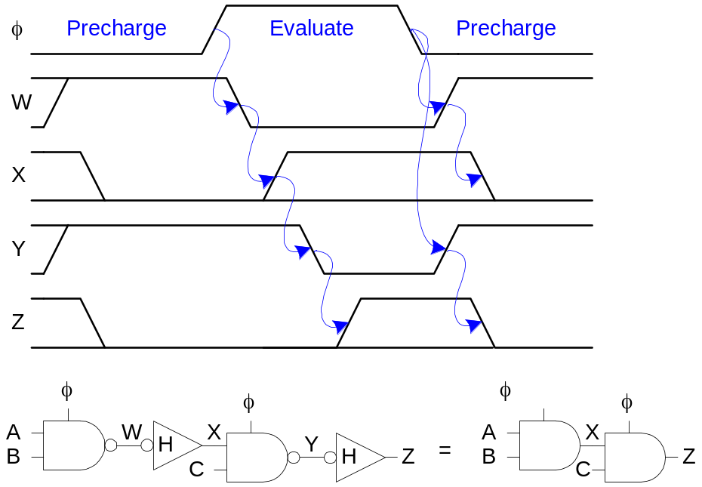
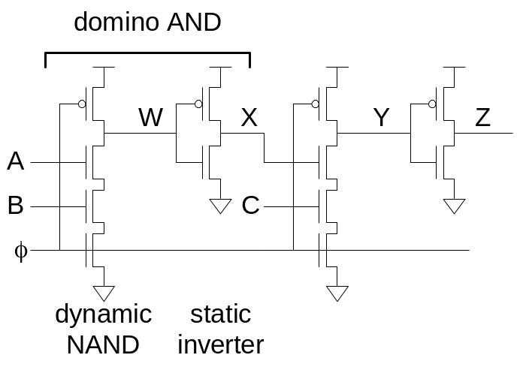
Domino Gates
Follow dynamic stage with inverting static gate
  Dynamic / static pair is called domino gate
  Produces monotonic outputs

Slide 25
CMOS Domino Logic
Only non-inverting structures possible, & charge redistribution can cause problems
Output buffer may be needed anyway due to loading

Slide 26
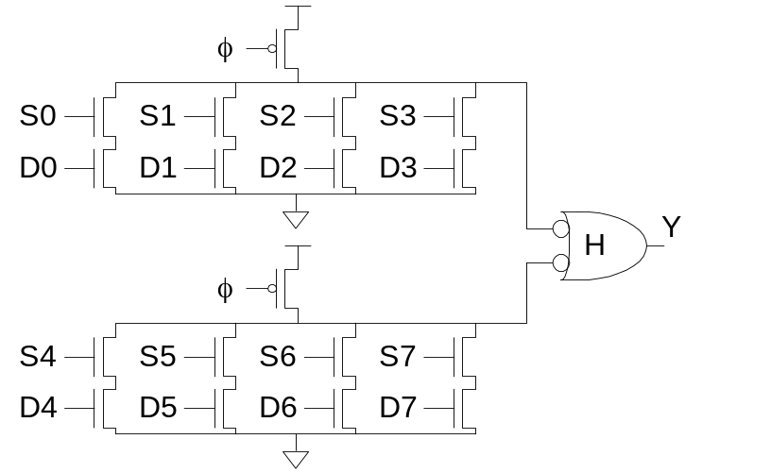
Domino Optimizations
Each domino gate triggers next one, like a string of dominos toppling over
Gates evaluate sequentially but precharge in parallel
Thus evaluation is more critical than precharge
HI-skewed static stages can perform logic

Slide 27
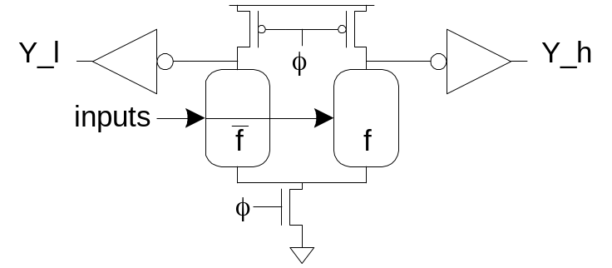
Dual-Rail Domino
Domino only performs noninverting functions:
  AND, OR but not NAND, NOR, or XOR
Dual-rail domino solves this problem
  Takes true and complementary inputs
  Produces true and complementary outputs
sig_h | sig_l | Meaning
0 | 0 | Precharged
0 | 1 | ‘0’
1 | 0 | ‘1’
1 | 1 | invalid

Slide 28
Example: AND/NAND
Given A_h, A_l, B_h, B_l
Compute Y_h = A * B, Y_l = ~(A * B)

Slide 29
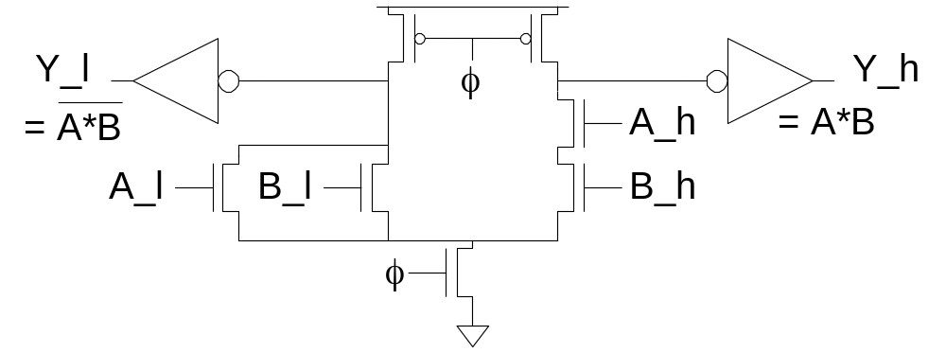
Example: AND/NAND
Given A_h, A_l, B_h, B_l
Compute Y_h = A * B, Y_l = ~(A * B)
Pulldown networks are conduction complements

Slide 30
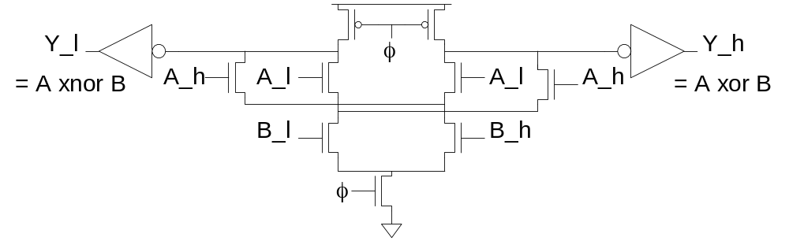
Example: XOR/XNOR
Sometimes possible to share transistors

Slide 31
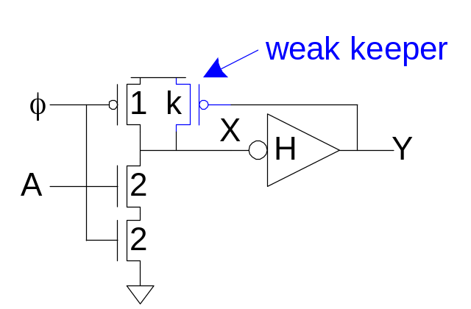
Leakage
Dynamic node floats high during evaluation
  Transistors are leaky (I_{OFF} ≠ 0)
  Dynamic value will leak away over time
  Formerly milliseconds, now nanoseconds!
Use keeper to hold dynamic node
  Must be weak enough not to fight evaluation

Slide 32
Static Domino CMOS
Make gate static with a weak p transistor
  Weak p’s have low gain, small W/L ratio
  Make Domino gate latching by adding feedback to a weak p transistor

Slide 33
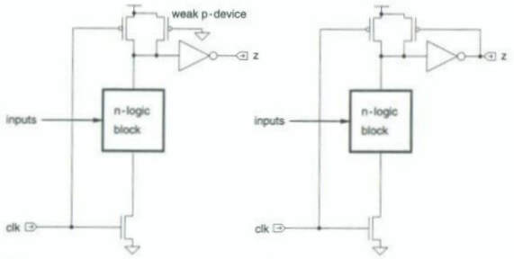
Static & Latched Domino Gates

Slide 34
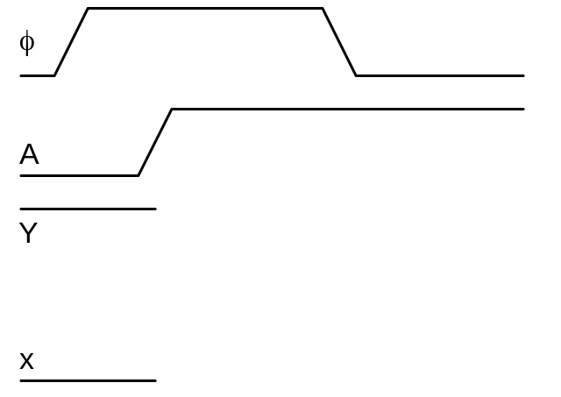
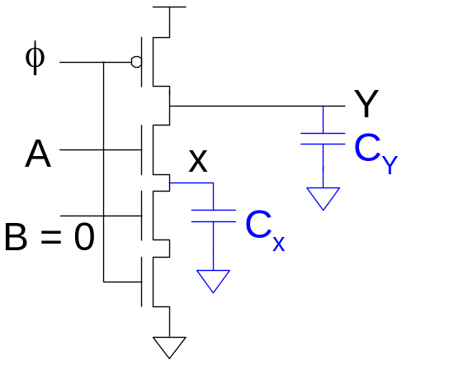
Charge Sharing
Dynamic gates suffer from charge sharing

Slide 35
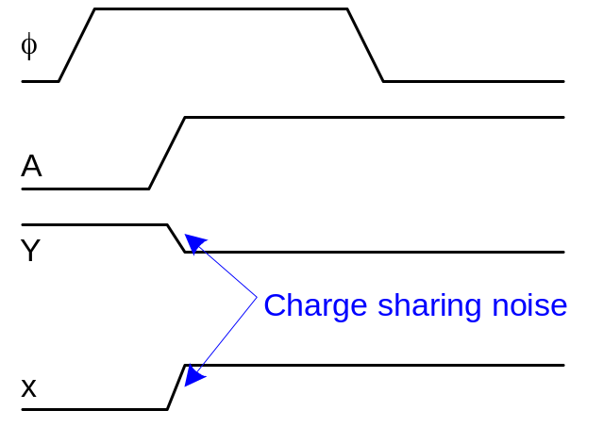
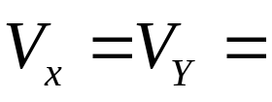
Charge Sharing
Dynamic gates suffer from charge sharing

Slide 36
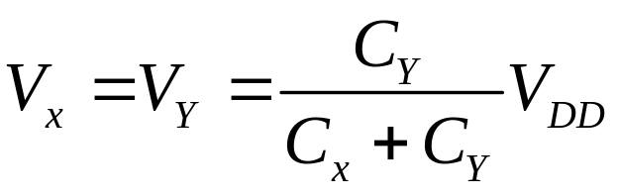
Charge Sharing
Dynamic gates suffer from charge sharing

Slide 37
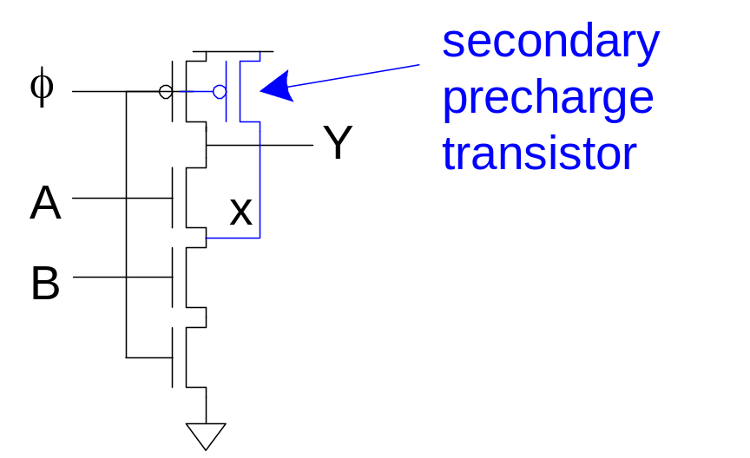
Secondary Precharge
Solution: add secondary precharge transistors
  Typically need to precharge every other node
Big load capacitance C_{Y} helps as well

Slide 38
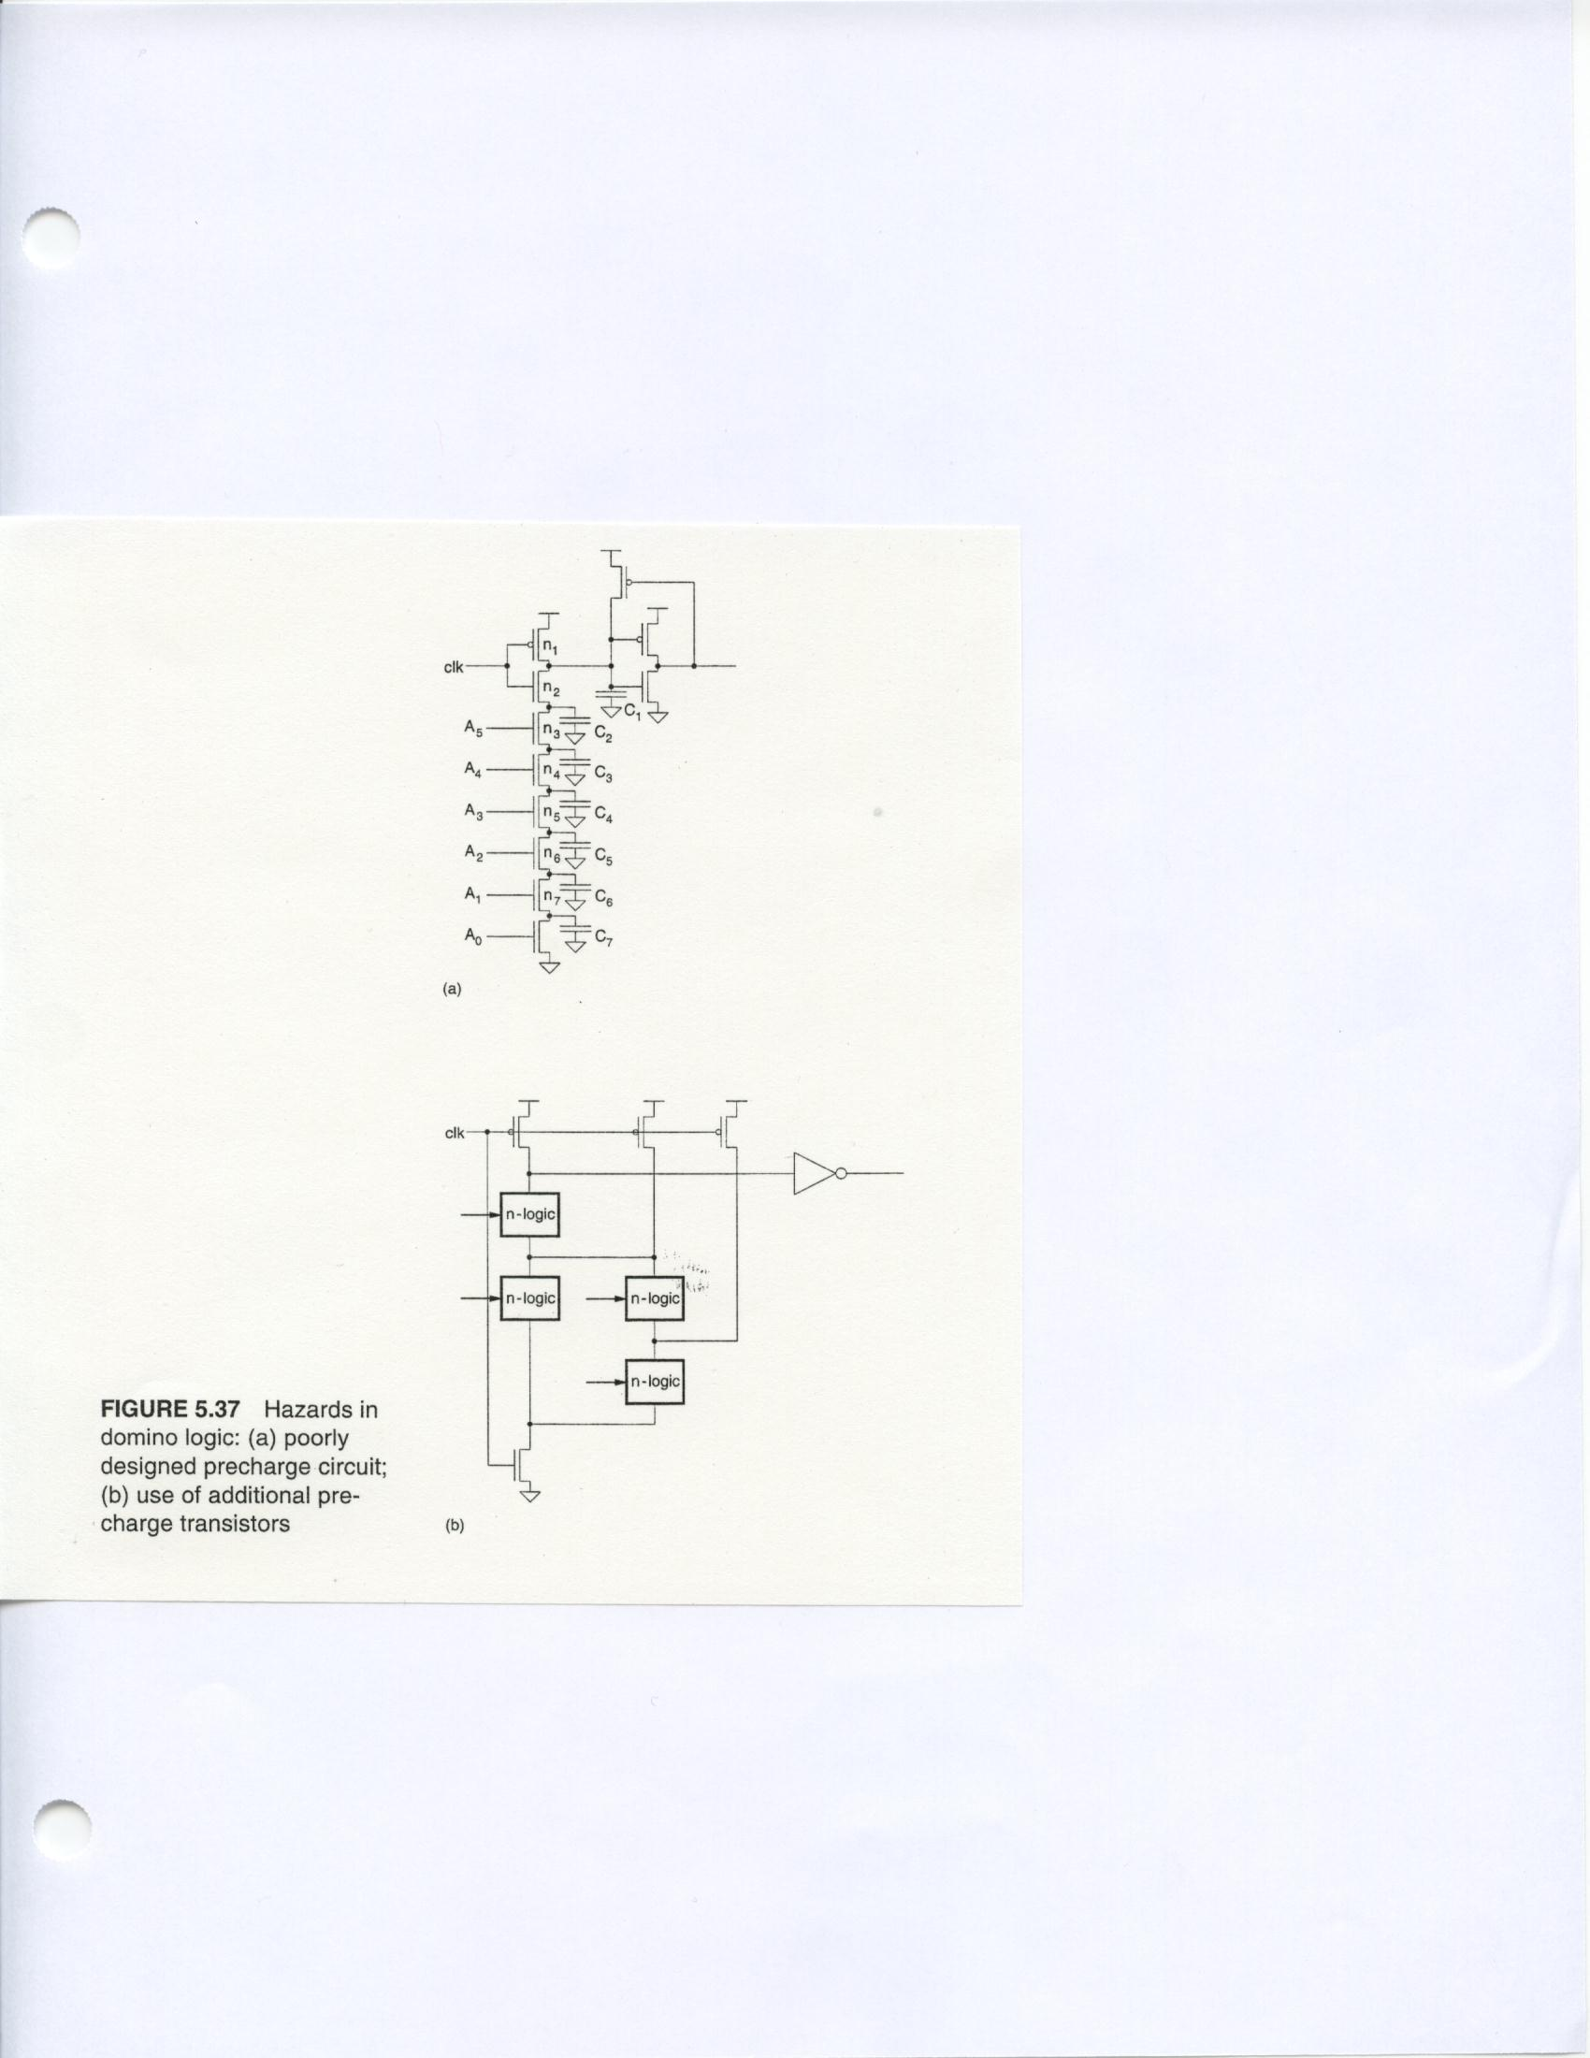
Precharging Problems

Slide 39
Precharging Problems
Clocked n transistor is closest to gate output
If C₂ – C₇ are charged low, A₀ is low, A₁-A₅ are high
When Clk has a , charge stored in C is dumped into C₂ – C₇
This charge sharing can lower C₁ charge so much that gate output of buffer switches

Slide 40
Voltage After Evaluation
V_{n1} = C₁ V_{DD}
Σ C_{i} + C₁
If C₁ = 3 X C₂, C₂ = C₃ = C₄ = C₅ = C₆ = C₇
V_{n1} = 3C₂ V_{DD} = 0.3 V_{DD} = 1.5 V
6 C₂ + 3 C₂
This falls below inverter threshold
Inverter erroneously switches
7
i = 2

Slide 41
Circuit Fix
Put clocked n-transistor at bottom of n-tree
Alternate solution – precharge intermediate nodes in complex Domino gate

Slide 42
Added Prechargers to Correct Gate Behavior

Slide 43
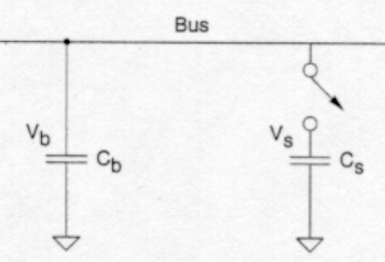
Charge Sharing
Q_{b} = C_{b} V_{b} ; Q_{s} = C_{s} V_{s}
Total charge:
Q_{T} = C_{b} V_{b} + C_{s} V_{s}
Total C:
C_{T} = C_{b} + C_{s}

Slide 44
Charge Sharing (cont’d.)
When switch closed,
V_{R} = Q_{T} = C_{b} V_{b} + C_{s} V_{s}
C_{T} C_{b} + C_{s}
If V_{b} = V_{DD} & V_{b} >> V_{s},
V_{R} = V_{DD} C_{b}
C_{b} + C_{s}
Therefore, 10 C_{s} < C_{b} for reliable data transfer from C_{b} to C_{s}
Big problem in dynamic logic & dynamic memories
[
]

Slide 45
Noise Sensitivity
Dynamic gates are very sensitive to noise
  Inputs: V_{IH} ≈ V_{tn}
  Outputs: floating output susceptible noise
Noise sources
  Capacitive crosstalk
  Charge sharing
  Power supply noise
  Feedthrough noise
  And more!

Slide 46
Domino Summary
Domino logic is attractive for high-speed circuits
  1.5 – 2x faster than static CMOS
  But many challenges:
    Monotonicity
    Leakage
    Charge sharing
    Noise
Widely used in high-performance microprocessors

Slide 47
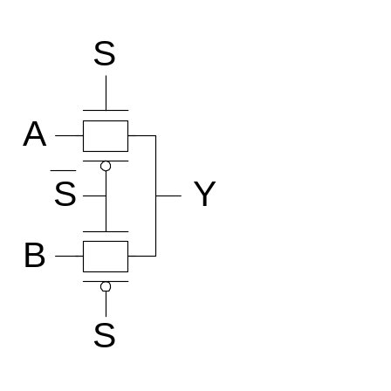
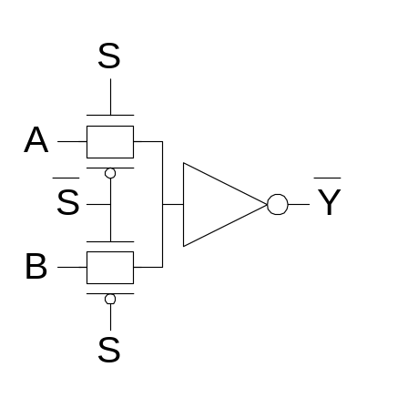
Pass Transistor Circuits
Use pass transistors like switches to do logic
Inputs drive diffusion terminals as well as gates
CMOS + Transmission Gates:
  2-input multiplexer
  Gates should be restoring

Slide 48
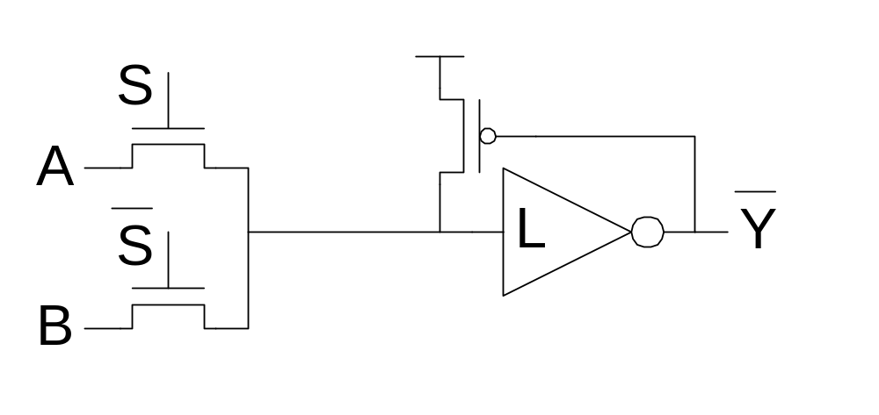
LEAP
LEAn integration with Pass transistors
Get rid of pMOS transistors
  Use weak pMOS feedback to pull fully high
  Ratio constraint

Slide 49
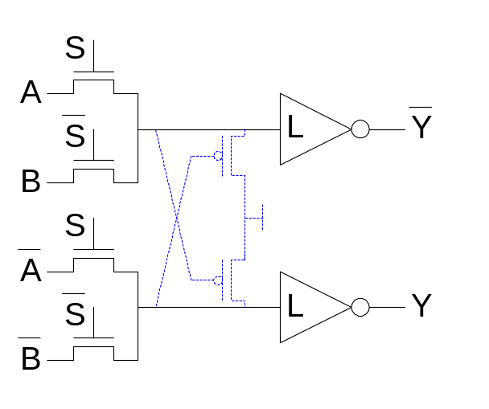
CPL
Complementary Pass-transistor Logic
  Dual-rail form of pass transistor logic
  Avoids need for ratioed feedback
  Optional cross-coupling for rail-to-rail swing

Slide 50
Summary
Pseudo-nMOS Logic
Dynamic Logic
Pass Transistor Logic

